Slide 1
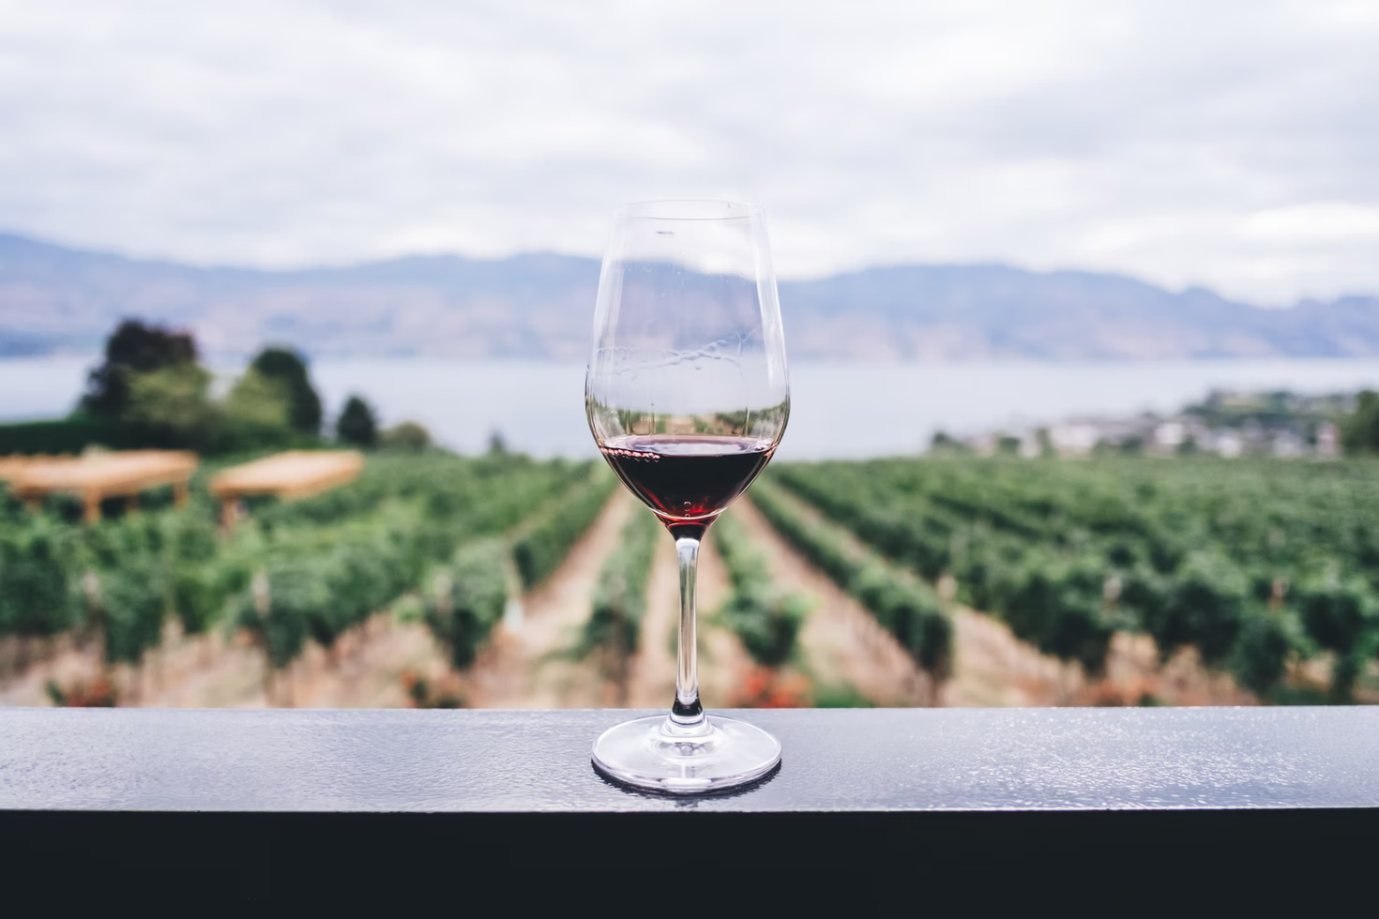
Red Wine Quality Prediction

Slide 2
Table of content
Introduction
Setup
Exploring Variables
Convert to a Classification Problem
Preparing Data for Modelling
Modelling
Feature Importance

Slide 3
Introduction
Dataset: Red wine quality
Using the red wine quality dataset, we build various classification models to predict whether a particular red wine is of “good quality”or not
Each wine in this dataset is given a “quality” score between 0 and 10. For the purpose of this project, we converted the output to a binary output where each wine is either “good quality” (>=7) or not (<=6). The quality of a wine is determined by 11 input variables:

Slide 4
Introduction
Fixed acidity
Volatile acidity
Citric acid
Residual sugar
Chlorides
Free sulfur dioxide
Total sulfur dioxide
Density
pH
Sulfates
Alcohol
Notes:
We are a group of wine enthusiast and have tried and sampled many different types of wine in the past. However, having sampled a variety of different types of wine, we are still unsure of what makes a good wine

Slide 5
Setup
Objectives:
To experiment with different classification methods to see which yields the highest accuracy
To determine which features are the most indicative of a good quality wine

Slide 6
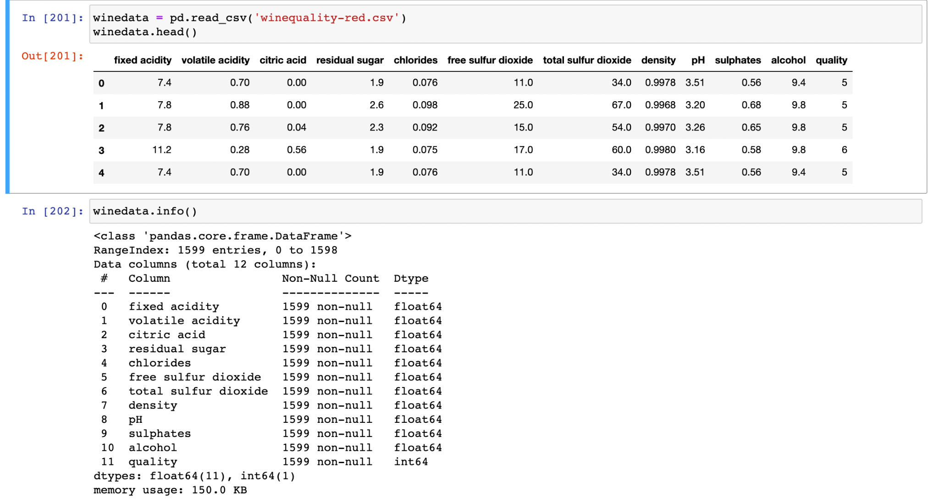
Setup

Slide 7
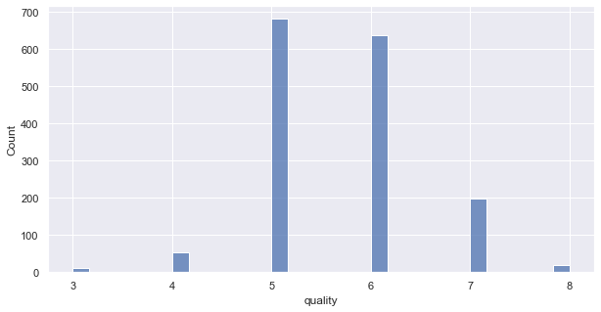
Exploring variables
The graph belows shows the histogram of “quality variable”
Notes:
Firstly, we wanted to know the distribution of the “quality” variables in the data set to

Slide 8
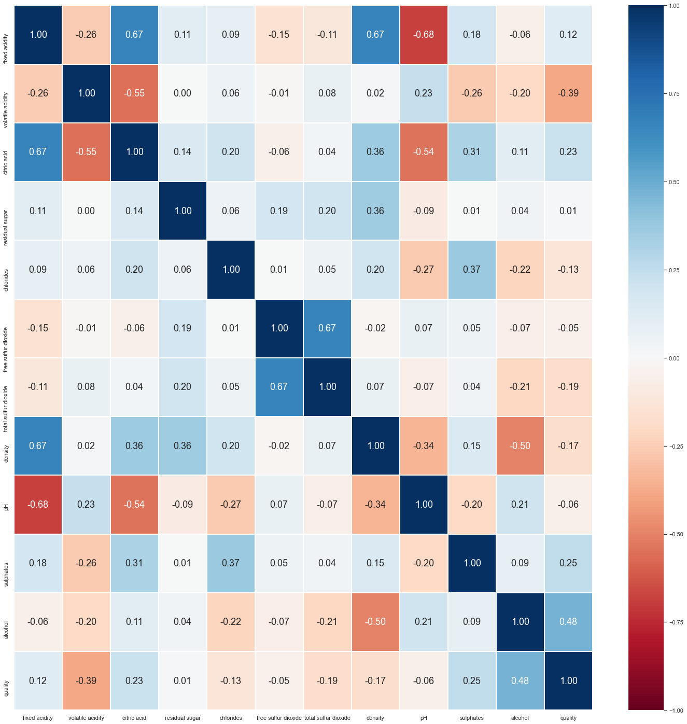
Exploring variables

Slide 9
Preparation of Data for modelling
Since this is the classification problem, we want to classify the quality into “good” and “bad” (binary outputs).
Quality 7 and above are considered “good”, while the rest are considered “bad”.
We split the data into train and test set with 80% for train and 20% for test

Slide 10
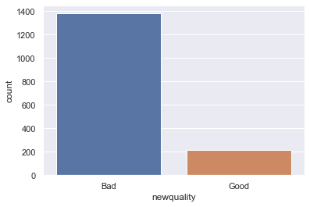
Converting to a classification problem
Good(>=7): 217 vs Bad(<=6):1382
Notes:
We then proceeded on the separate the quality of wines into “good’ and “bad” with good having a score of 7 and above while bad having a score of 6 and below. We wanted to make sure that there was a

Slide 11
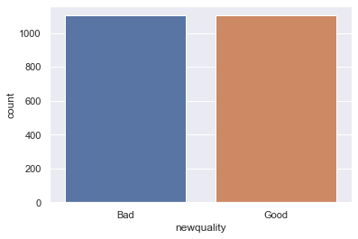
Resampling (Oversampling the Minority)
Preparation of Data for modelling
Oversampling the minority will increase the number of datapoints in the “good” class, aiming to evenly distribute the classes in the training set.
Notes:
From the previous diagram, we can tell that the number of “bad” and “good” classes are not balanced. Good samples are much fewer than bad ones, this may affect the accuracy of our final result. Thus we need to do resampling, in this case, we chose to oversample the minority, which is the “Good” class.
Oversampling the minority will increase the number of datapoints in the “good” class, this will evenly distribute the classes in the training set.

Slide 12

Feature Scaling (Standardization)
The independent features all have different magnitude, range and units. This may affect the accuracy of the algorithms
Standardization transform the data so that its distribution will have a mean of 0 and a standard deviation of 1
Notes:
We also noticed that the independent features all have different magnitude, range and units. This may affect the accuracy of the algorithms as well.
Thus we performed standardization on the independent variables, which transform the data so that its distribution will have a mean of 0 and a standard deviation of 1

Slide 13
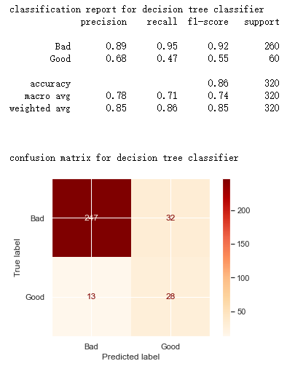
Modelling
1. Decision Tree
test accuracy: 0.859375

Slide 14
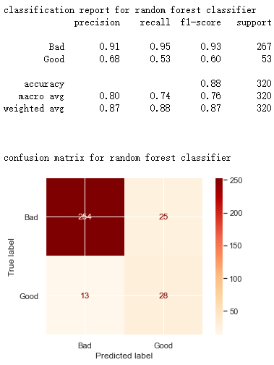
2. Random forest
Modelling
test accuracy: 0.88125

Slide 15
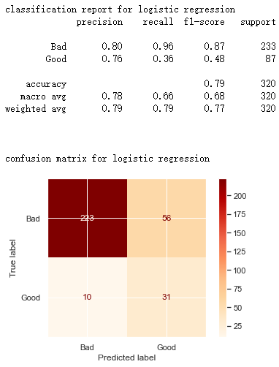
3. Logistic Regression
Modelling
test accuracy: 0.859375

Slide 16
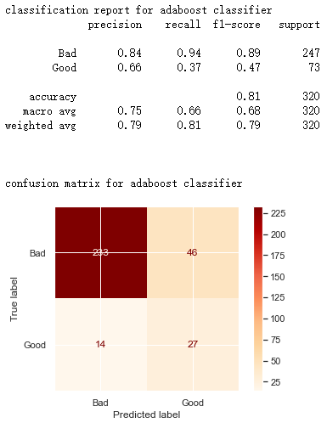
4. AdaBoost
Modelling
test accuracy: 0.8125

Slide 17
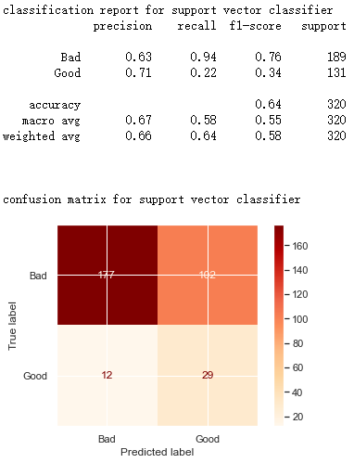
5. Support vector
Modelling
test accuracy: 0.64375

Slide 18
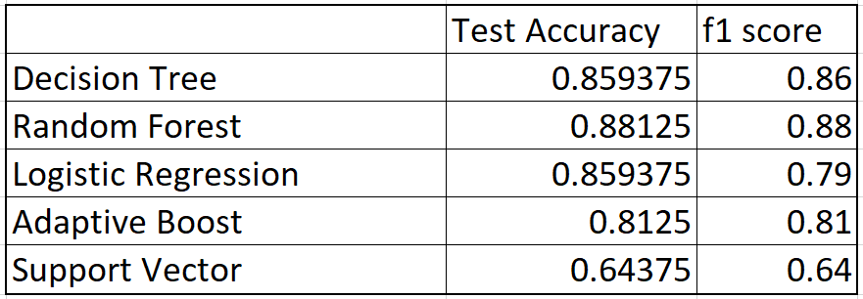
Modelling
Conclusion on accuracy:
By looking at the test accuracy,
Random Forest > Logistic Regression ≈ Decision Tree > Adaboost > Support Vector
Considering the f1 score, Decision Tree wins over Logistic Regression by 0.07 (0.86 vs. 0.79).
Therefore, the final conclusion on the five models is:
Random Forest > Decision Tree > Logistic Regression > Adaboost > Support Vector

Slide 19
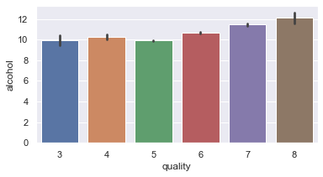
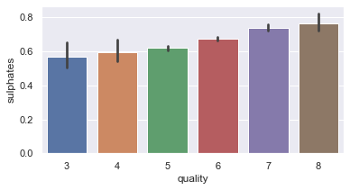
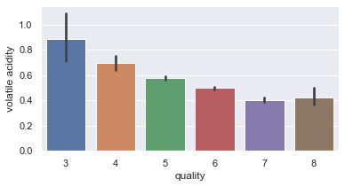

Slide 20
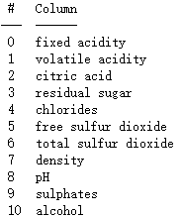
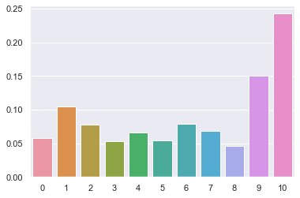
Feature Importance
Since random forest is the best model for our project, we would graph the featured importance based on this model.
From the graph , “alcohol”, “sulphates” and “volatile acidity” are the three most significant determinants for wine quality.

Slide 21
Thank You :)

